Slide 1
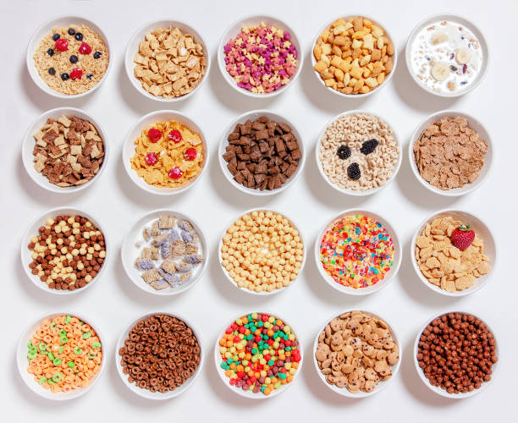
CEREAL DATA ANALYSIS :
KAULIK PODDAR , ROLL - MD2207
SAHELI DATTA, ROLL - MD2213
TIYASA DUTTA , ROLL- MD2225
Group-6

Slide 2
Description Of The Dataset :-
Data name : Cereal Data from different brands.
Number of Observations : 43
Number of Variables : 9
Number of Continuous Variables : 8
Number of Categorical Variables :1
Names of Continuous Variables:
Name of Categorical Variable :
NOTE : Lots of repetitions of observations in the data.
Calories , Protein , Fat , Sodium , Fibre , Carbohydrates , Sugar , Potassium.
Manufacturer
Three categories : Type-1,Type-2, Type-3

Slide 3
EDA of the Cereal Data(being partial to the groups!!):-
Summary :
 | Calories | Protein | Fat | Sodium | Fibre | Carbohyd-rates | Sugar | Potassium
Min | 50 | 1 | 0 | 0 | 0 | 1 | 0 | 15
1st Qu | 100 | 2 | 0 | 145 | 0.5 | 12 | 3 | 37.5
Median | 110 | 2 | 1 | 190 | 1 | 14 | 8 | 60
Mean | 107.9 | 2.465 | 0.9767 | 180.5 | 1.714 | 14.26 | 7.605 | 84.42
3rd Qu | 110 | 3 | 1.5 | 220 | 2.850 | 17 | 12 | 110
Max | 160 | 6 | 3 | 320 | 9 | 22 | 15 | 320

Slide 4
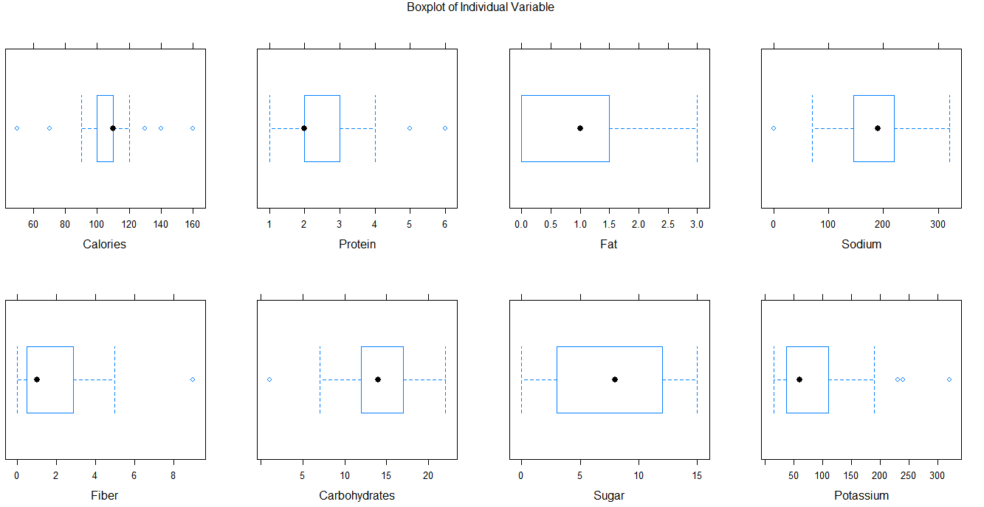
EDA (contd.):-
Boxplot :

Slide 5
EDA (contd.):-
Comment :-
No missing values in the dataset.
One outlier in Sodium and Carbohydrates and three in Potassium and also present in other variables but are not considered as there are many repeated values.
From the Boxplot we see :
Sugar- Symmetrically distributed.
Protein , Fiber , Carbohydrates– Positively skewed distribution.
Calories , Fat , Sodium – Negatively skewed distribution.

Slide 6
EDA(contd.) :-
Correlation heatmap of the variables :

Slide 7
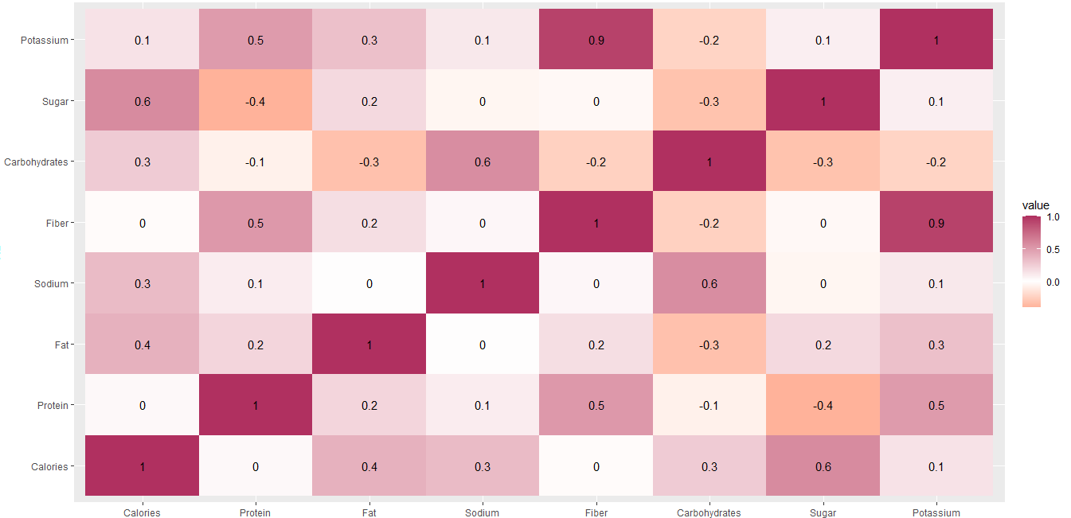

Slide 8
Problem : Repetition of obs. Solution : Adding jitter!!
Variables | Jitter(amount) | Reason
Calories | runif (43,0,7.8) | Many same obs.
Protein | runif(43,0,0.5) | Many same obs.
Fat | runif(43,0.1,0.5) | Many same obs.
Sodium | runif(43,0.001,0.005) | 0 obs.
Fiber | runif(43,0,2) | Many same obs.
Sugar | runif(43,0.001,0.002) | 0 obs.

Slide 9
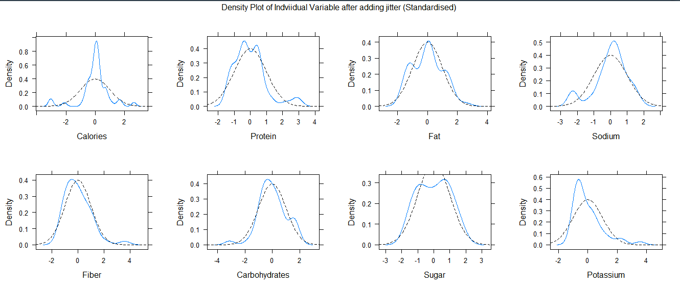
Checking for Univariate Normality :-
1st Tool : Density Plot of each variable :

Slide 10
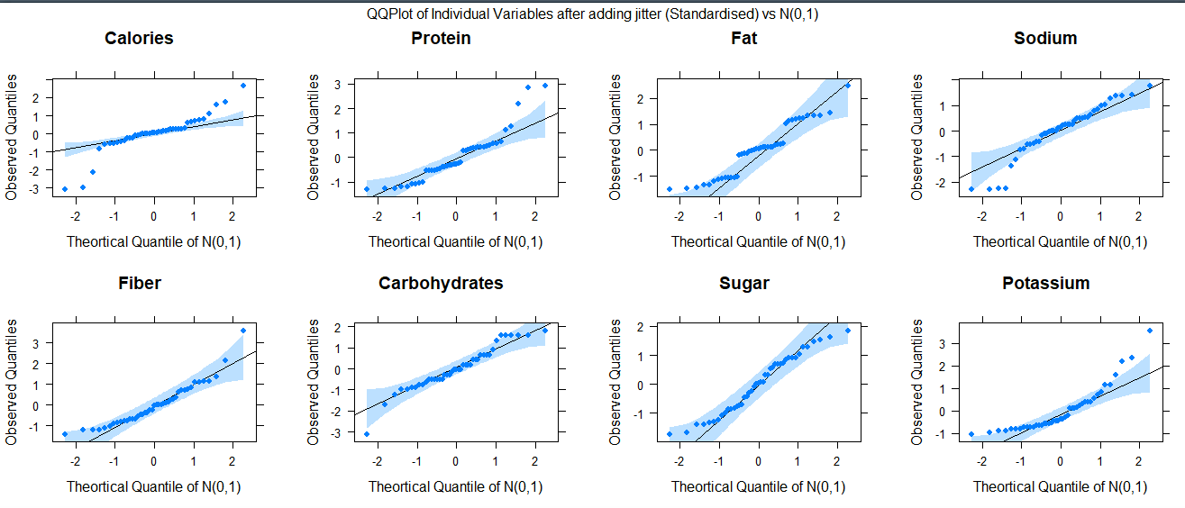
Checking for Univariate Normality (contd.):-
2nd Tool : QQ Plot:

Slide 11
Checking for Univariate Normality (contd.) :-
Shapiro Wilk’s Test : the confirmatory one;
Note : Level of significance is 0.01.
We see that most of the variables are not normal.
Variable | p-value | Decision
Calories | 3.15E-05 | Reject
Protein | 0.001392742 | Reject
Fat | 0.006614561 | Reject
Sodium | 0.00819374 | Reject
Fiber | 0.000387199 | Reject
Carbohydrates | 0.065805603 | Accept
Sugar | 0.0468579 | Accept
Potassium | 0.000013 | Reject

Slide 12
Is Transformation a solution to this problem??
Univariate Boxcox Transformation :
Variable | Lamda
Calories | 1.8412333
Protein | 0.1225622
Fat | 0.8700501
Sodium | 1.6051347
Fiber | 0.3700856
Carbohydrates | 1.2873041
Sugar | 0.8189196
Potassium | -0.1400536

Slide 13
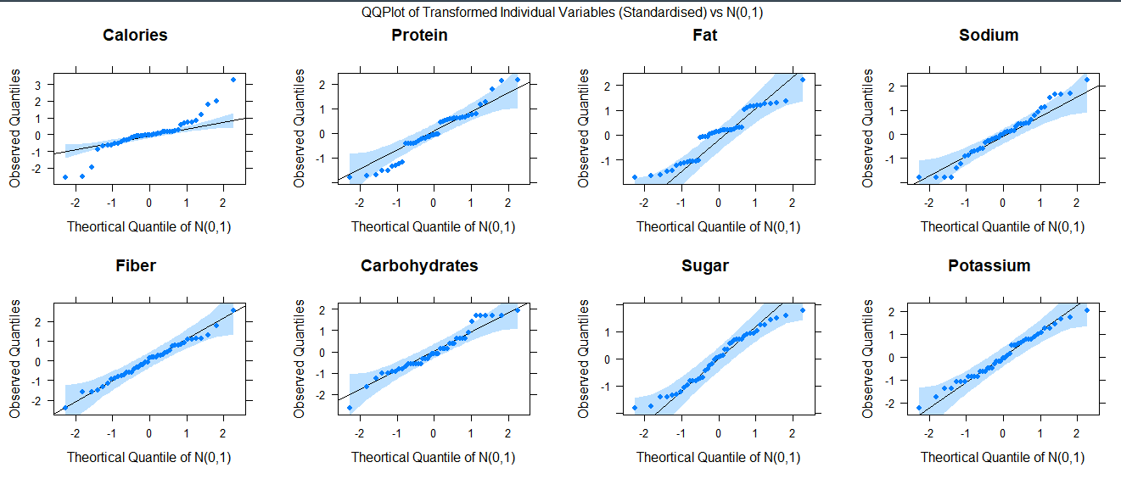
Checking for Normality after Transformation:-
QQ Plot :

Slide 14
Checking for Normality after Transformation:-
Shapiro Wilk’ Test ;
Note that Calories and Fat these two variables do not follow normal as a result checking for Multivariate normal is useless.
So we now have to give importance to the grouping factor.
Variables | p- value | Decision
Calories | 0.0001697 | Reject
Protein | 0.1474622 | Accept
Fat | 0.0070846 | Reject
Sodium | 0.4565389 | Accept
Fiber | 0.9046218 | Accept
Carbohydrates | 0.1071514 | Accept
Sugar | 0.0591866 | Accept
Potassium | 0.8077318 | Accept

Slide 15
PCA :-
The rotation matrix of the principal components of 8 variables is given below.
Variables | PC1 | PC2 | PC3 | PC4 | PC5 | PC6 | PC7 | PC8
Calories | -0.11429 | 0.656598 | 0.135123 | -0.10048 | 0.453703 | -0.13578 | 0.468935 | 0.288583
Protein | -0.42084 | -0.22794 | 0.253063 | -0.37168 | 0.551363 | 0.420374 | -0.24231 | -0.17124
Fat | -0.31569 | 0.301787 | -0.16565 | -0.68746 | -0.43197 | -0.25131 | -0.12506 | -0.20937
Sodium | -0.02254 | 0.273076 | 0.591711 | 0.075408 | -0.50185 | 0.555796 | 0.086933 | 0.028197
Fiber | -0.55812 | -0.13467 | 0.069649 | 0.376351 | -0.0757 | -0.19426 | 0.452959 | -0.52463
Carbohydrates | 0.238093 | 0.113458 | 0.631592 | 0.058778 | 0.131506 | -0.53484 | -0.36979 | -0.29661
Sugar | -0.03834 | 0.565922 | -0.36207 | 0.374915 | 0.123791 | 0.25364 | -0.43508 | -0.37102
Potassium | -0.5831 | -0.0001 | 0.072717 | 0.296338 | -0.11558 | -0.21133 | -0.40863 | 0.584717

Slide 16
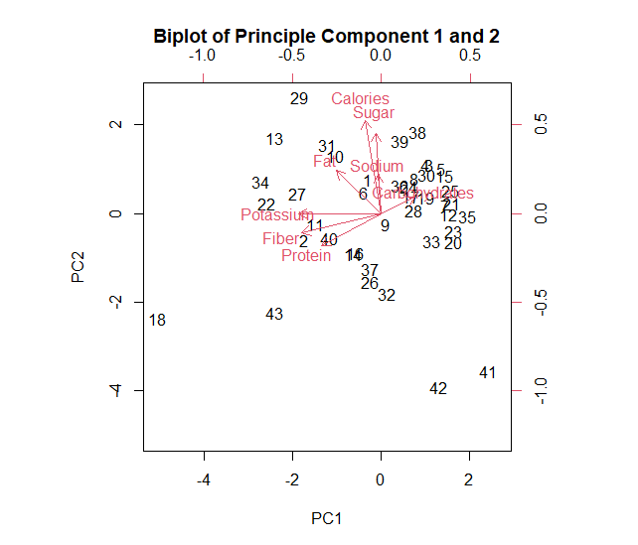
PCA (contd.):-
Biplot :

Slide 17
PCA (contd.):-
Principal Component | Proportion of variation explained | Cumulative Proportion of Variation
PC1 | 0.318446181 | 31.84462
PC2 | 0.231845224 | 55.02914
PC3 | 0.221103745 | 77.13951
PC4 | 0.108535420 | 87.99306
PC5 | 0.062162601 | 94.20932
PC6 | 0.044678557 | 98.67717
PC7 | 0.007562921 | 99.43346
PC8 | 0.005665352 | 100

Slide 18
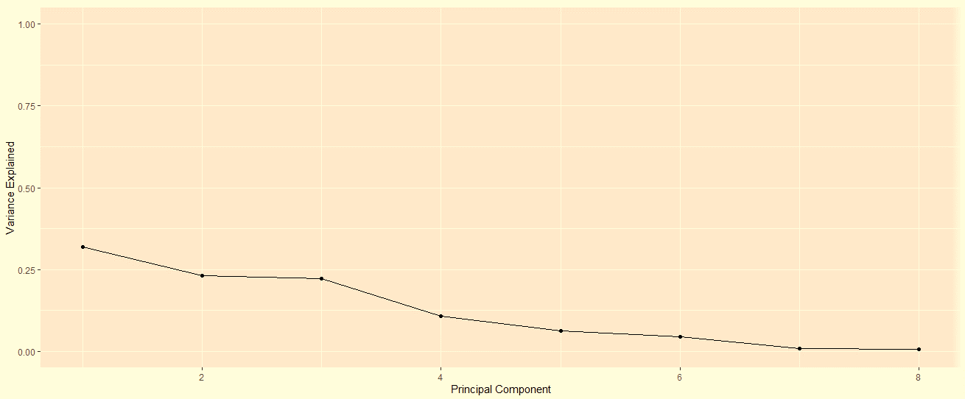
PCA (contd.):-
Scree Plot :

Slide 19
PCA (contd.):-
Comment :
Biplot suggests;
Effect of Potassium nd Fiber are more in first Principal component.
Effect of Calories and Sugar are more in the 2nd principal component.
All other variables have same effect on the both.
Scree plot suggests that the 6th,7th and 8th component are not able to explain much of the variability.
So what to do drop variables?? If not then what is the motive of doing PCA?

Slide 20
Till not univariate normality is not achieved!! Should consider the grouping factors now??
Being partial to the groups did not result much , so now going to consider them.
Again problem : 3 groups are present with too few obs in the 3rd group ; no of obs. are less than no.of variables , in a single word creating a lot of trouble in finding sample variance covariance matrix.
Solution :- Club the 3rd group with any of the other.
Club with which group??
Now PCA comes to play a role.
We extract the top 3 variables from the 1st PC and make a 3d plot.
Clubbing is done by visualising the 3D plot.

Slide 21
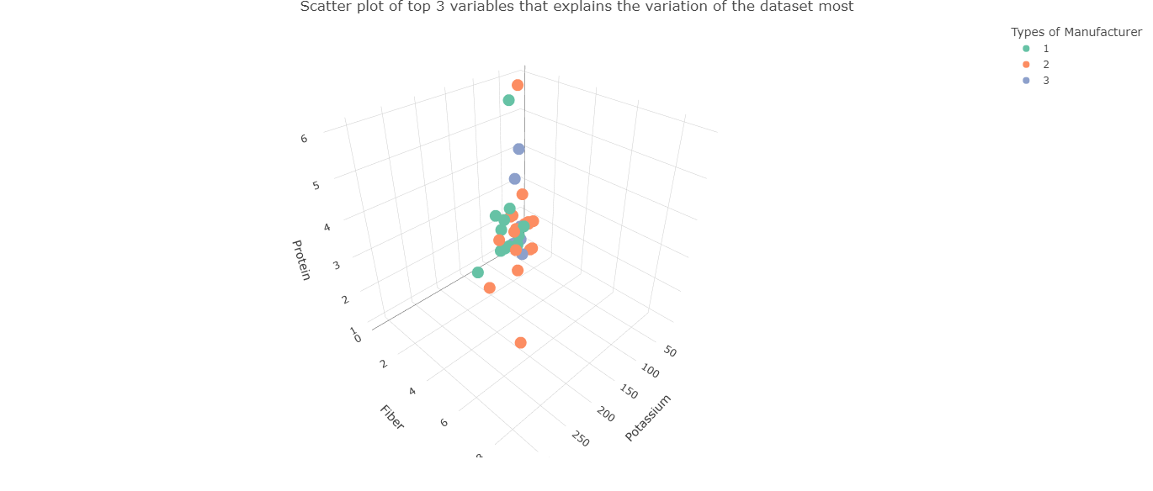
3D PLOT :

Slide 22
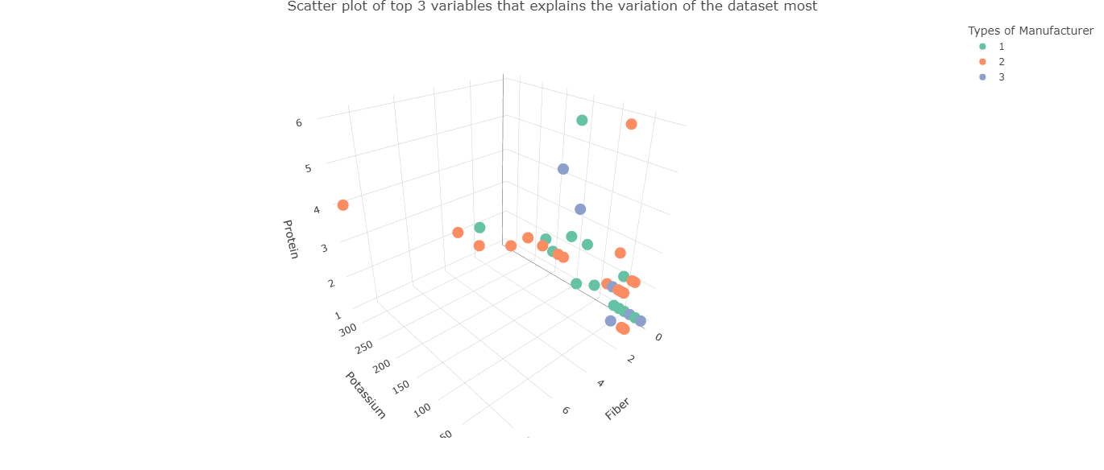

Slide 23
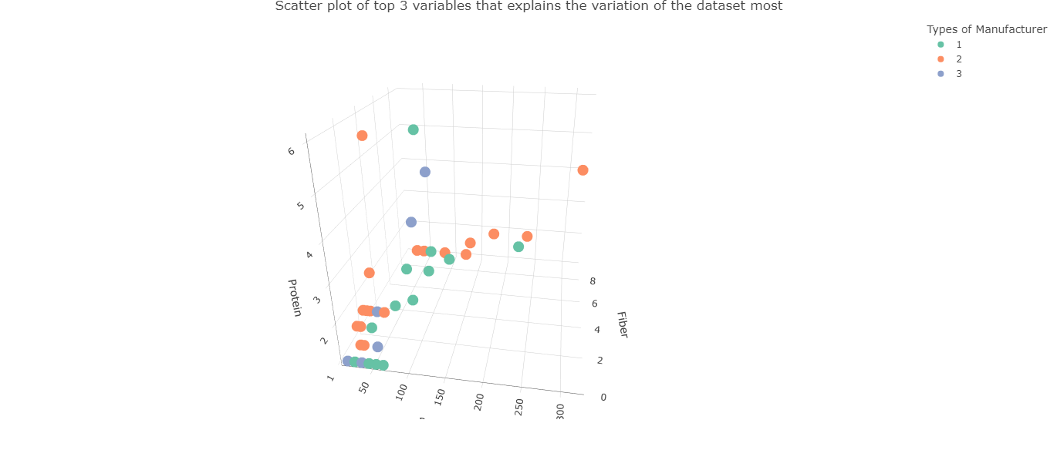

Slide 24
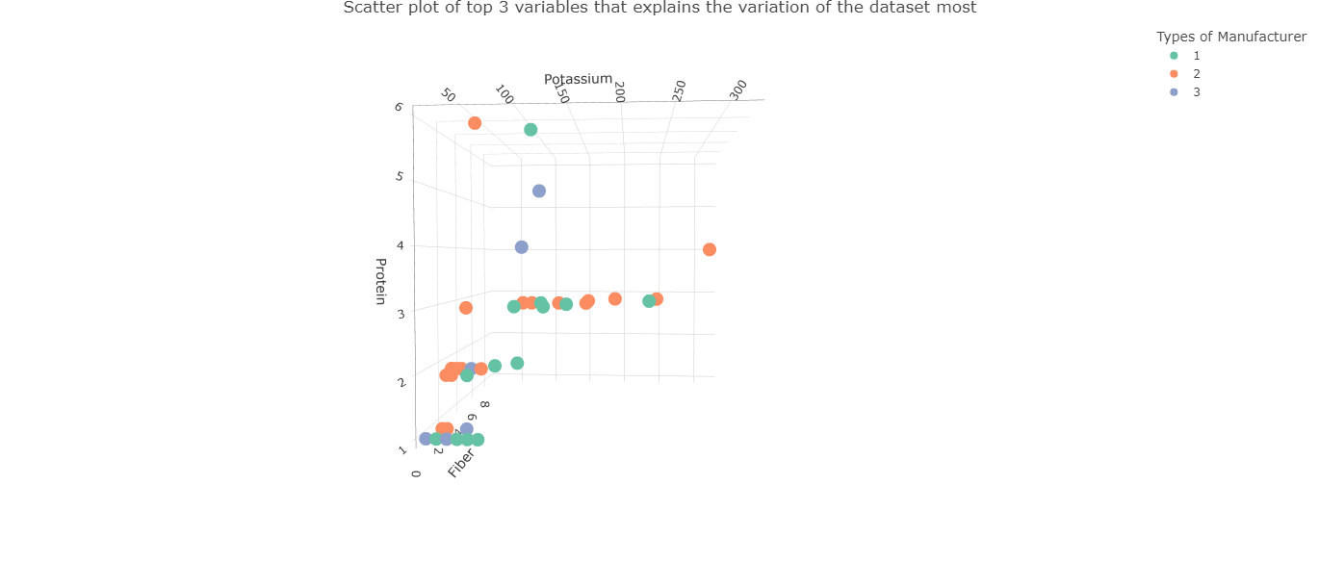

Slide 25
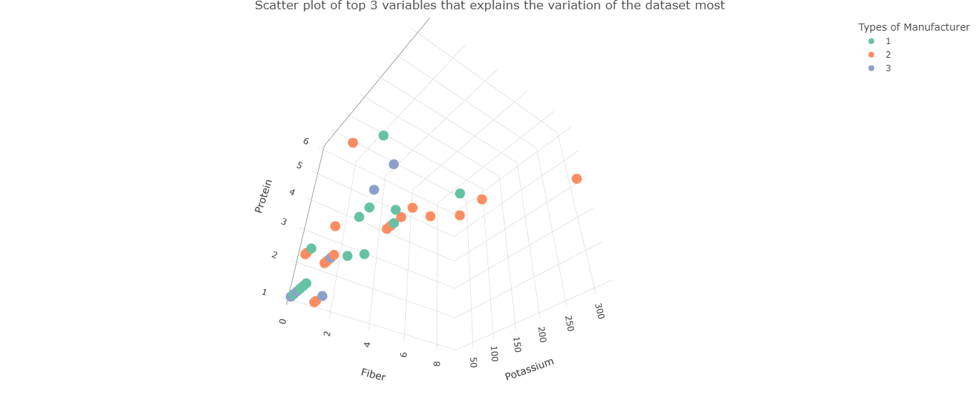

Slide 26
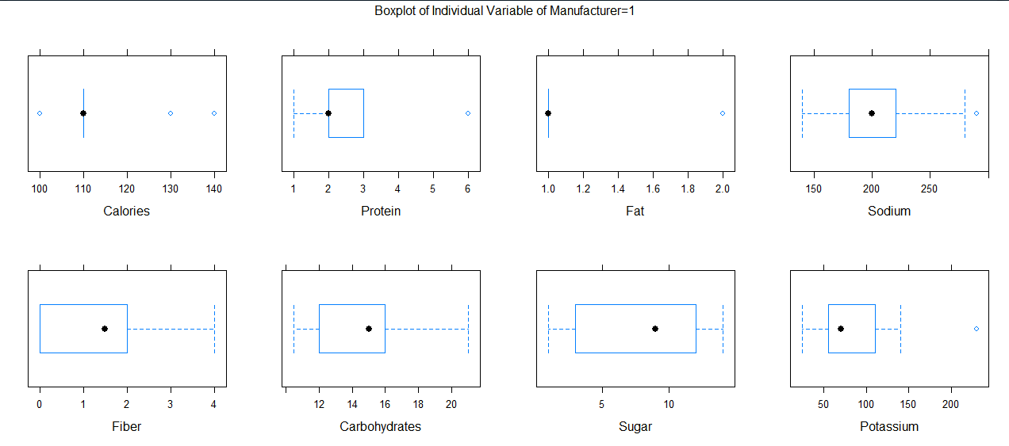
EDA (groupwise) :-
Group-1 :
Boxplot ;

Slide 27
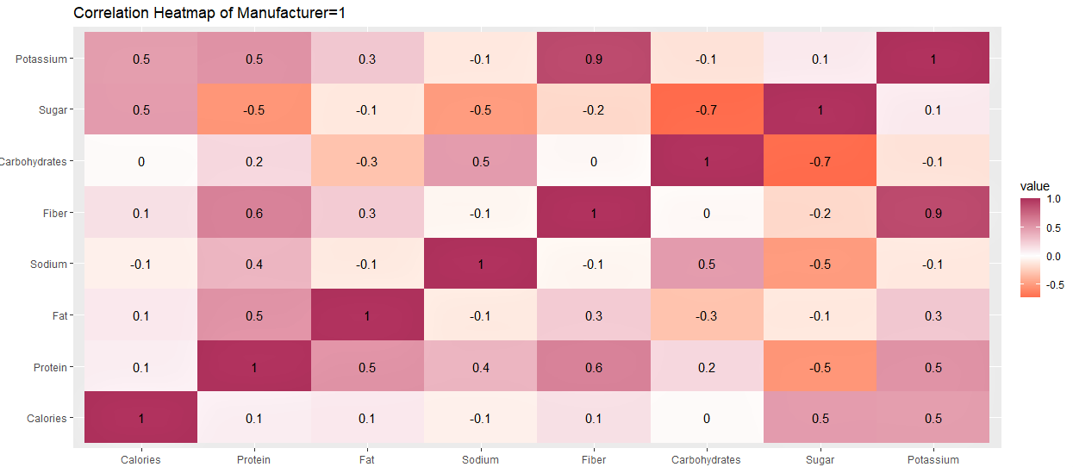
EDA (groupwise)(contd.):-
Correlation heatmap ;

Slide 28
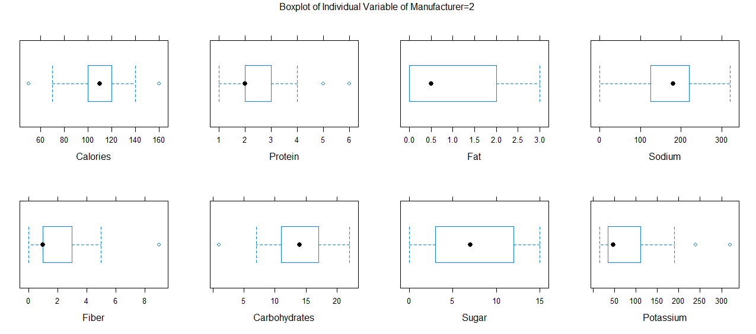
EDA (groupwise)(contd.):-
Group-2 :
Boxplot ;

Slide 29
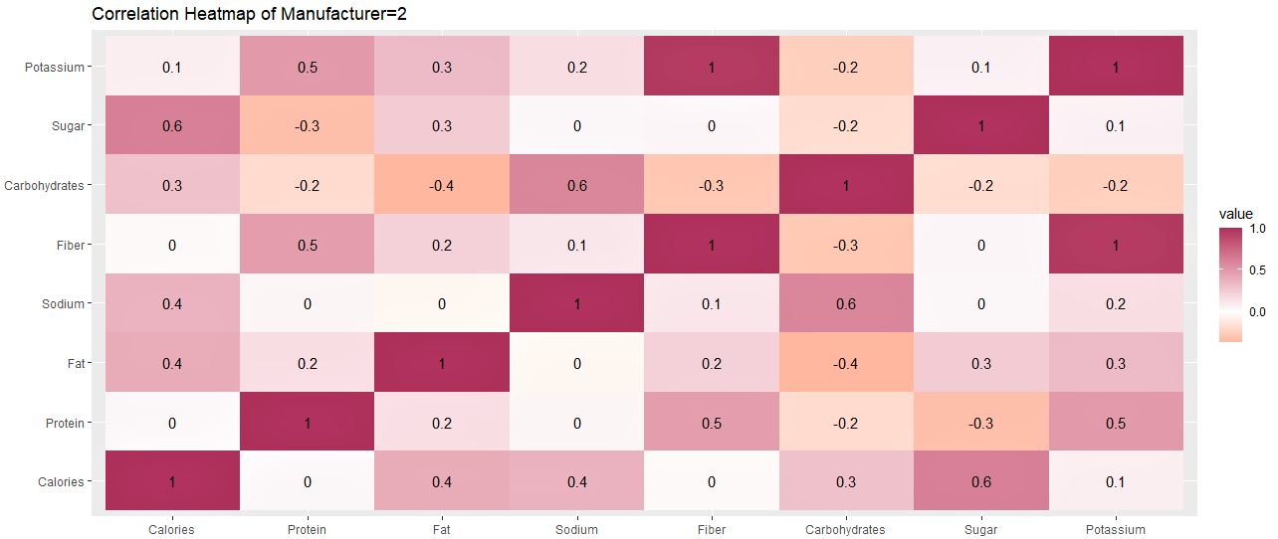
EDA (groupwise)(contd.):-
Correlation heatmap ;

Slide 30
OBSERVATION :-
In Group-2 almost all of the variables have more variation than that of the variables of group 1.
In Group-2 there is no negatively skewed variable.
We can see that number of uncorrelated variables is more in Group-2.

Slide 31
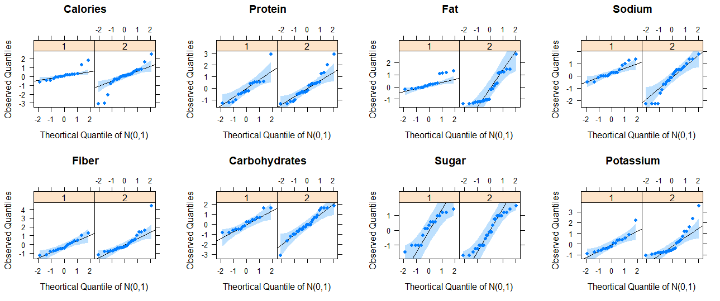
Checking for Univariate Normality(groupwise) !!
QQ Plot :

Slide 32
Checking for Univariate Normality(groupwise) !!
Group 2:-
Group 1:-
Test | Variable | Statistic | p-value | Normality
SW | Calories | 0.7818 | 0.0012 | NO
SW | Protein | 0.8256 | 0.0047 | NO
SW | Fat | 0.7538 | 0.0005 | NO
SW | Sodium | 0.9144 | 0.1185 | YES
SW | Fiber | 0.9686 | 0.793 | YES
SW | Carbohydrates | 0.9159 | 0.1259 | YES
SW | Sugar | 0.9125 | 0.1101 | YES
SW | Potassium | 0.8746 | 0.026 | YES
Test | Variable | Statistic | p-value | Normality
SW | Calories | 0.8728 | 0.0041 | NO
SW | Protein | 0.9142 | 0.033 | YES
SW | Fat | 0.8704 | 0.0036 | NO
SW | Sodium | 0.9318 | 0.0855 | YES
SW | Fiber | 0.863 | 0.0026 | NO
SW | Carbohydrates | 0.9562 | 0.3231 | YES
SW | Sugar | 0.9224 | 0.0511 | YES
SW | Potassium | 0.7921 | 0.0001 | NO

Slide 33
Transformation required again!!
Some of the variables were not normal in groupwise also.
This motivates us to perform boxcox transformation on those variables keeping the value of the lamda same in each of the group.
Variable | Power
Calories | 1.68149156
Protein | 0.32994981
Fat | 0.37779543
Fiber | -0.26965518
Potassium | 0.01459788

Slide 34
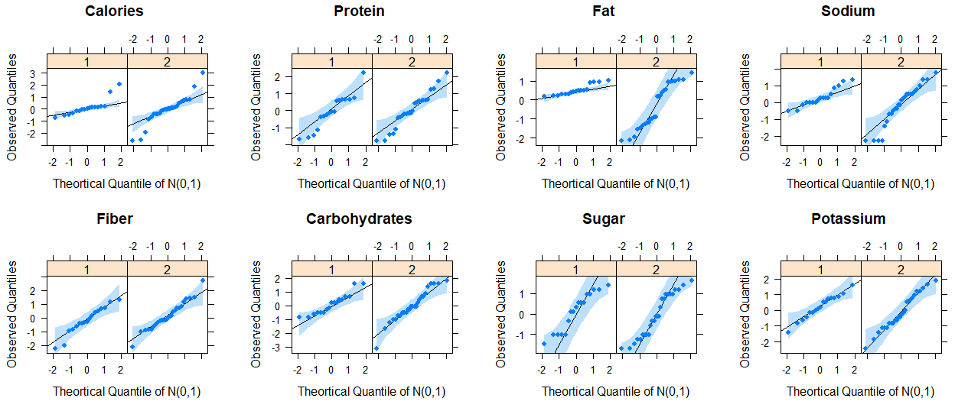
Checking Normality after Transformation :-
QQ Plot after transformation :
A
Apart from two variables Calories and Fat others are all univariate normal.

Slide 35
Checking for Multivariate Normality (groupwise):-
Confirmatory test : Royston Test present in the MVN package in R.
Result for Group 1 :
Result for Group 2 :
Test | H | p-value | MVN
Royston | 26.1739 | 0.00031 | NO
Test | H | p-value | MVN
Royston | 19.49517 | 0.01044421 | YES

Slide 36
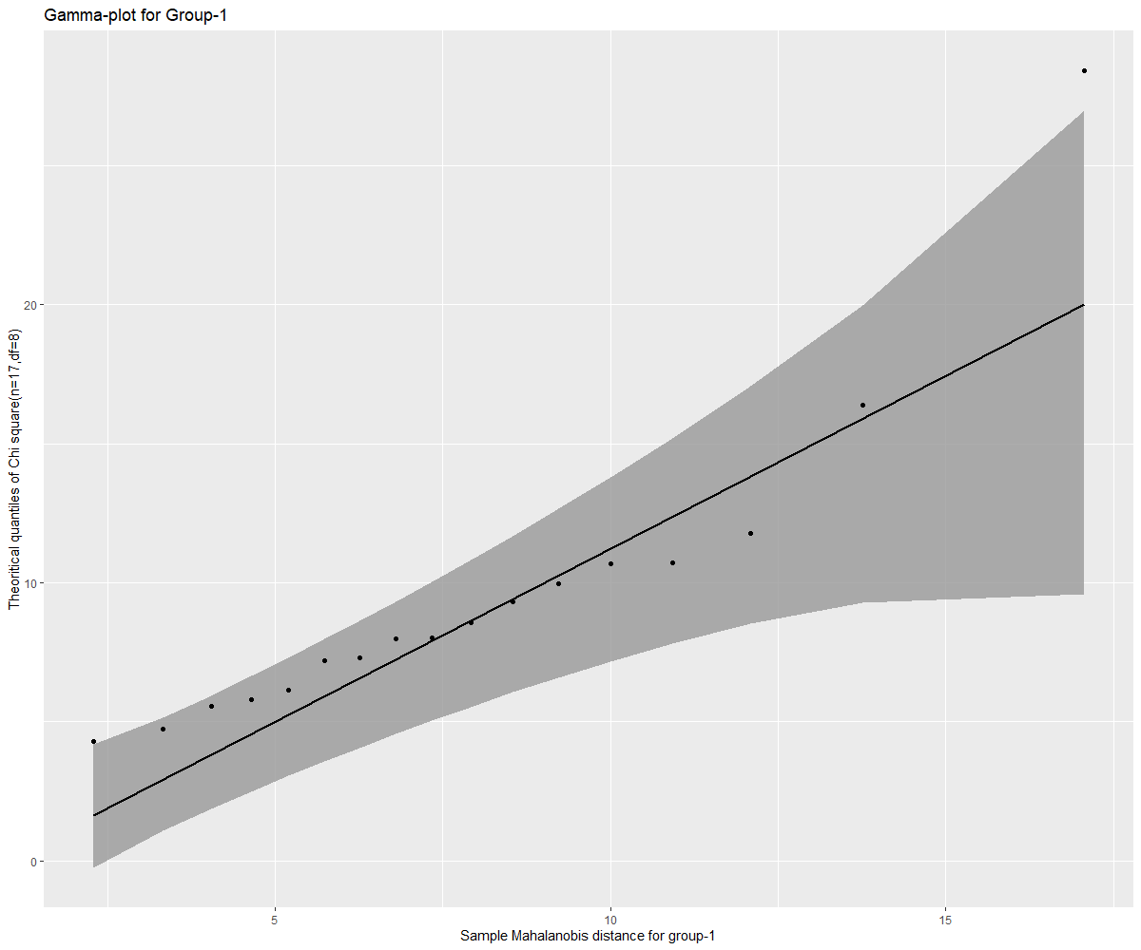
Checking for Multivariate Normality (groupwise):-
Gamma Plot :
Only for Group 1 :

Slide 37
Test for Equality of Covariance Matrices :
We perform Box-M test for this using the function boxM present in the heplots package in R.
Result :
Box-M test REJECTED!!
Leads us to perform QDA.
Obs. Value of the test statistic | Degrees of freedom | Level of Significance | p-value
64.851 | 36 | 0.01 | 0.002238

Slide 38
Discrimination Analysis : QDA
Why Discriminant analysis is to be done?
Box-M test is rejected which implies the variance-covariance matrix of two groups are not same.
Want to see how well the two groups are separated.
Why QDA ?
The data is coming from a multivaruate normal distribution.
The variance covariance matrix of two groups are not same.

Slide 39
Discrimination Analysis : QDA (contd).
Here, we use the following function :
model=qda(Manufacturer~.,data=data4)

Slide 40
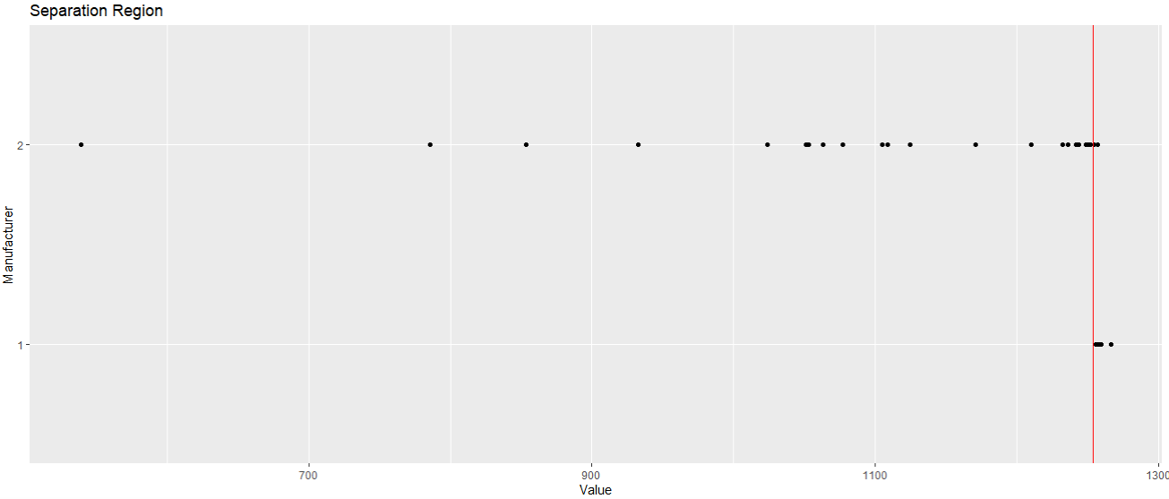
Discrimination Analysis : QDA (contd).

Slide 41
Discrimination Analysis : QDA (contd).
Here, we use the following function :
model=qda(Manufacturer~.,data=data4,CV=T)

Slide 42
Discrimination Analysis : QDA (contd.)
Want to judge the performance of the classification rule.
Can be done by calculating error rule.
Use Apparent Error Rate (APER), which is a valid estimator Actual Error Rate (AER).
But APER tends to underestimate AER (6.8%).
Problem can be solved by these two methods,
i. Spliting the dataset into train set and test set.
ii. Cross Validation Method.
Very less data points in each variable (43).
Cannot use method-i.
By method-ii, we calculate find out confusion matrix and APER.

Slide 43
Discrimination Analysis : QDA (contd.)
This is our confusion matrix------------
APER comes out 34.89%.
Not very good since we assume the data follows multivariate normal but it is actually not.
QDA is not robust to departure from normality.
 | Population 1 (Predicted) | Population 2 (Predicted)
Population 1 (Actual) | 5 | 12
Population 2 (Actual) | 5 | 21

Slide 44
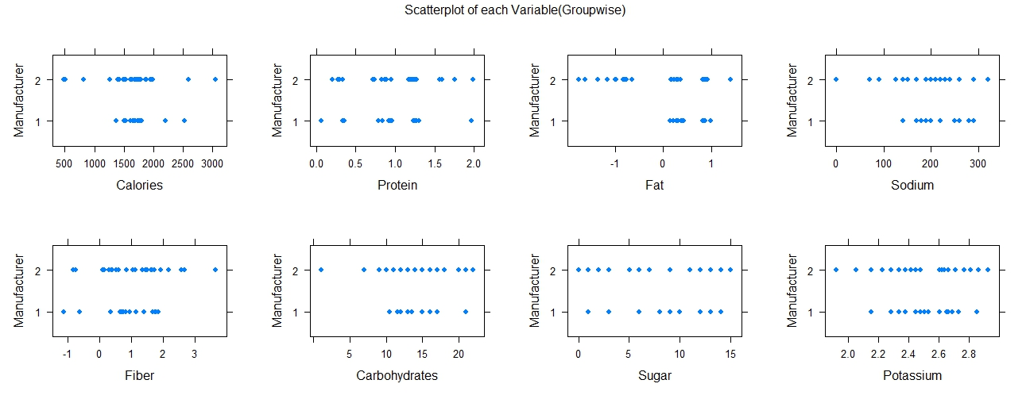

Slide 45
Factor Analysis :-
The Correlation heatmap suggests that there is a high correlation among the data which motivates us for Factor Analysis.
Confirmatory Test : Bartlett’s Test
Function used cortest.bartlett in psych package.
So at 0.01% level of significance we reject the null hypothesis.
And proceed for Factor Analyis.
cortest.bartlett(data4[,-1])
Value of the test statistic | p-value | DF
164.2903 | 3.117315e-21 | 28

Slide 46
Factor Analysis (contd.) :-
QUESTION : How many Factors will serve the purpose?
Scree Plot helped us to answer this!
4 Principal components were needed to explain 87% of the total variability so we have taken number of factors to be 4.
We look at our data once again !

Slide 47
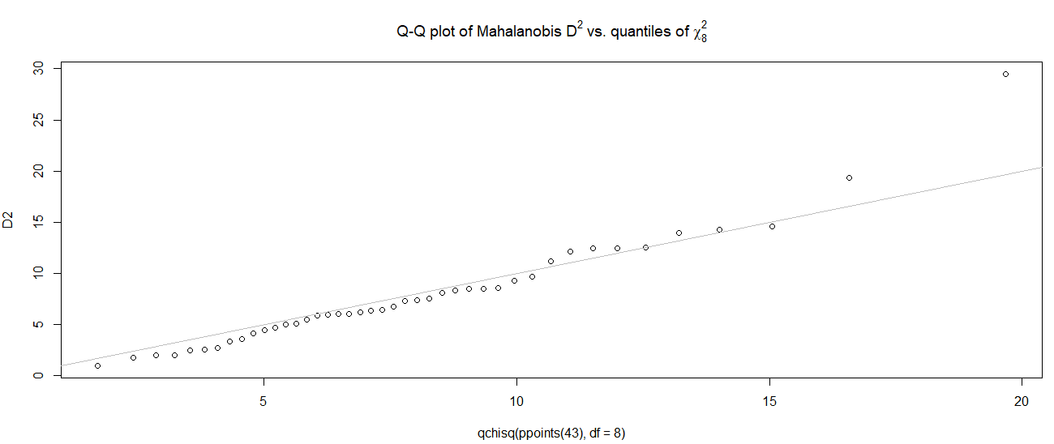
Revisiting our Data:-
Gamma Plot for the entire data :
We can conclude from the Gamma Plot that the data is approximately MVN.

Slide 48
Factor Analysis (contd.) :-
We perform two methods for Factor Analysis- MLE and PCA both.
No .of factors chosen=4 (seemed suggestive from the Scree Plot)
Function for Factor Analysis by MLE method is factanal() in stats package in R :
Function for Factor Analysis by PCA method is fa() in psych package in R :
factanal (data4[,-1],factors=4,rotation="none",scores="Bartlett")
fa(data4[,-1],nfactors=4,fm="pa",max.iter=1000,rotate="none",scores="Bartlett")

Slide 49
Which is better MLE or PCA?
We see that the communalities are greater than 1 for PCA so we work with MLE only avoiding any kind of spurious correlation.
Method-MLE | Calories | Protein | Fat | Sodium | Fiber | Carbohydrates | Sugar | Potassium
Communality | 0.727 | 0.678 | 0.773 | 0.418 | 0.835 | 0.995 | 0.995 | 0.896
Uniqueness | 0.273 | 0.322 | 0.227 | 0.582 | 0.165 | 0.005 | 0.005 | 0.104
Method-PCA | Calories | Protein | Fat | Sodium | Fiber | Carbohydrates | Sugar | Potassium
Communality | 0.537 | 0.601 | 0.754 | 0.376 | 0.818 | 1.095 | 1.662 | 0.925

Slide 50
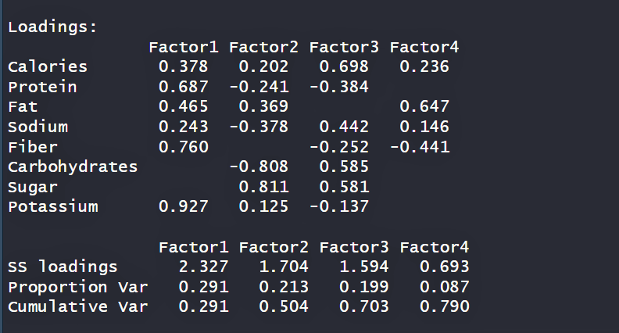
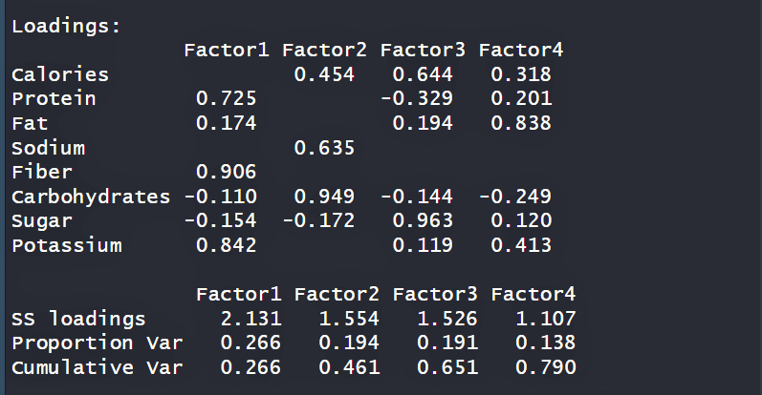
Is Rotation required?
Loading Matrix (No rotation)
Loading Matrix (Varimax rotation)

Slide 51
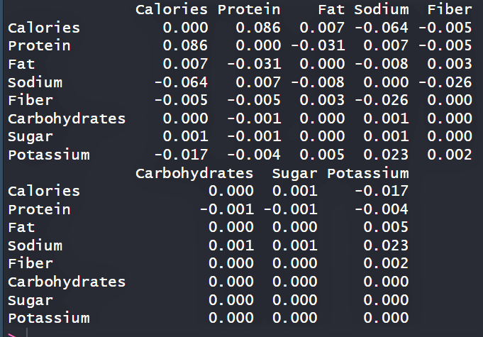
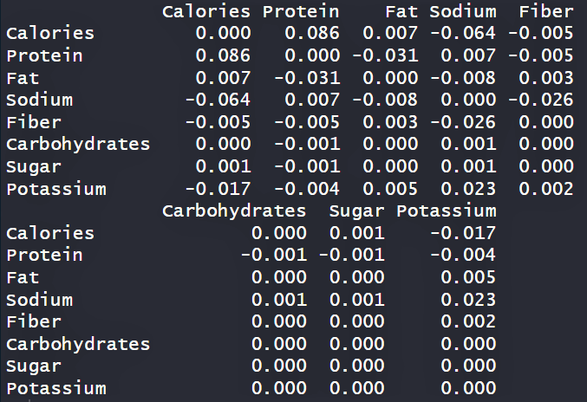
Just a check to the Theory known!!
Residual matrix for no rotation
No CHANGE!
Residual matrix for Varimax rotation

Slide 52
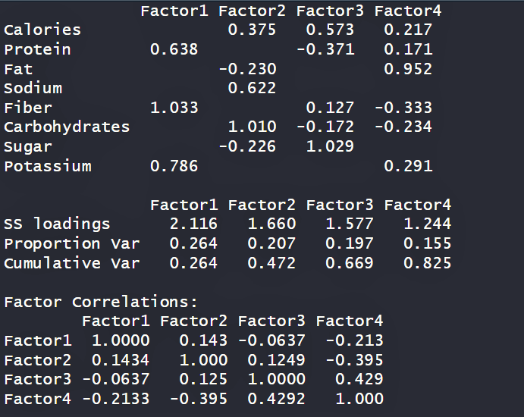
PROMAX Rotation :-
We have also considered the Promax Rotation but it do not perform well since the number of obs. is small.

Slide 53
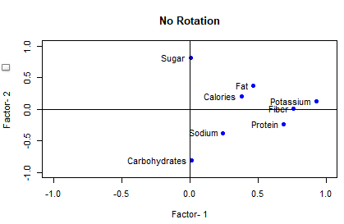
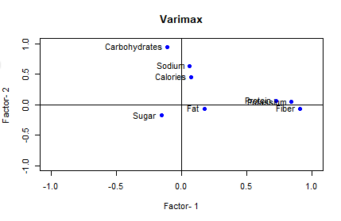
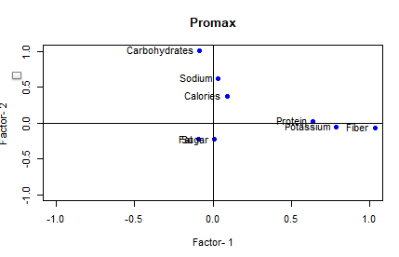
Comparison of the first two loadings for the first two factors :-

Slide 54
Factor Scores :-
No Rotation : Varimax Rotation:
Factor 1 | Factor 2 | Factor 3 | Factor 4
-0.003 | 0.870 | -0.302 | 0.753
1.181 | -1.298 | -0.682 | 1.342
-0.738 | 1.062 | 0.556 | -0.530
-0.393 | 1.063 | 0.562 | -0.073
-0.572 | 0.081 | 0.422 | -0.079
0.556 | 0.723 | -0.108 | -0.029
Factor 1 | Factor 2 | Factor 3 | Factor 4
-0.157 | -0.708 | 0.318 | 0.888
0.569 | 0.808 | -1.555 | 1.397
-0.477 | -0.548 | 1.199 | -0.546
-0.343 | -0.410 | 1.149 | -0.009
-0.559 | 0.088 | 0.345 | -0.280
0.595 | -0.049 | 0.462 | 0.332

Slide 55
PROFILE ANALYSIS :-
BoxM test rejected thus no homogeneity among the covariance matrices.
Hence not meaningful to test for the equality of the group means.
Thus Profile Analysis is not suitable for this data.

Slide 56
CONFIDENCE ELLIPSOID :-
Steps :
Firstly we have chosen two variables which were normal with a high p-value.
The variables are Fiber and Potassium.
If we consider them together its following Bivariate normal also with a very high p –value.

Slide 57
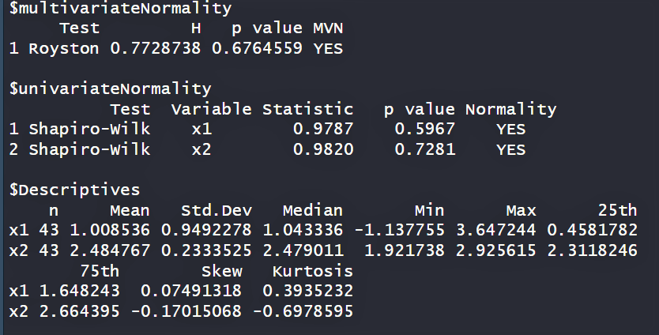
CONFIDENCE ELLIPSOID (contd.):-
The result are :
We use the confidenceEllipse function in MVQuickGraphs package.

Slide 58
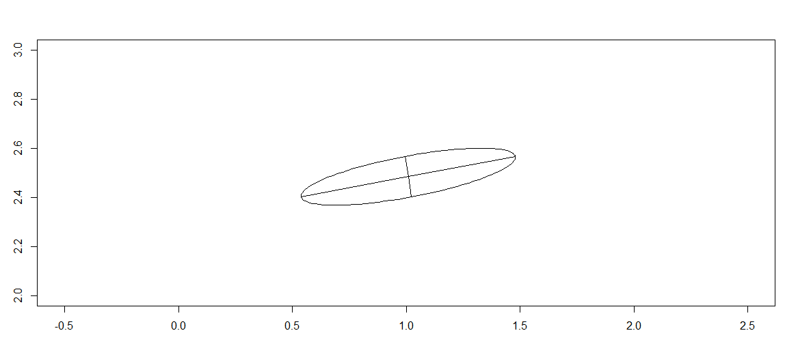
CONFIDENCE ELLIPSOID (contd.):-
confidenceEllipse(mean,eig=eigen(sigma.est),n=43,p=2,alpha=0.01,xl=c(-0.5,2.5),yl=c(2,3))

Slide 59
Comparing Bonferroni’s simultaneous Confidence Interval and Hotelling T² Intervals:-
Now we just want to make a comparison between the Bonferroni’s simultaneous confidence interval and T² confidence interval.
Hotelling T² confidence interval for µ₁ (mean of fiber):
Bonferroni’s simultaneous confidence interval for µ₁ (mean of fiber):
Hotelling T² confidence interval for µ₂ (mean of potassium):
Bonferroni’s simultaneous confidence interval for µ₂ (mean of potassium):
(0.1737169,1.786926)
(0.5399971,1.42065)
(2.291618,2.677915)
(2.379327,2.59021)

Slide 60
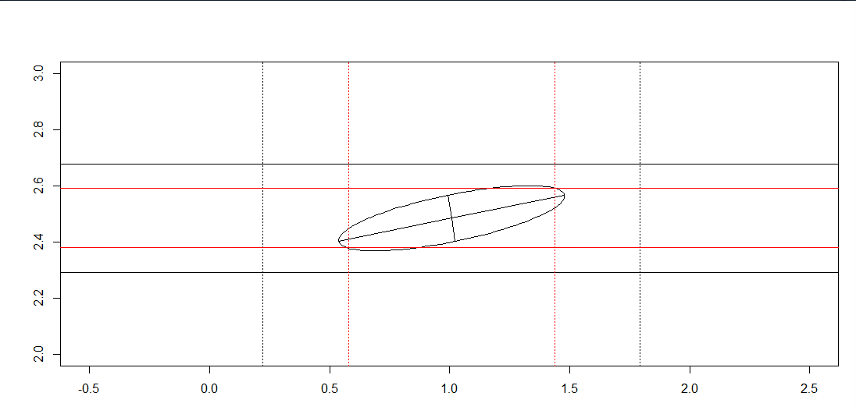
PLOT :- Bonferroni’s simultaneous intervals are more precise!!

Slide 61
SUMMARY :-
Repetition of observations so jitter is added.
In 3rd group no. of obs. is less than number of variables so in order to club it with another group we perform PCA and the variables having high variation in the first principal component are plotted in a 3d plot.
Its better to consider the grouping factor for checking normality.
There is no homogeneity among the covariance matrices for the two groups.
QDA does not perform well.
In Factor Analysis MLE method is much more consistent along with Varimax rotation.
Lastly we see that for a real life data set Bonferroni’s simultaneous CI works better than Hotelling T² intervals.

Slide 62
………..THANK YOU………..

